Slide 1


WEATHER DATA
ANALYSIS
BRISTI HALDER 22CD3009
VEDANSHI PATHAK 22CD3033

Slide 2


Overview of the Project
Exploratory Data Analysis is an approach to analyze data
To summarize the main characteristics of data, and better understand the data set.
It also allows us to quickly interpret the data and adjust different variables to see their effect.
The three main steps to get a perfect EDA are extracting the data from an authorized source,
Cleaning and processing the data, and performing data visualization on the cleaned data set.

Slide 3



Overview of the Project
Many sites provide historical data on many meteorological parameters such as pressure, temperature, humidity, wind speed, visibility, etc.
We are going to analyze the Weather data set.
Our main aim is to perform data cleaning, data normalizing, testing the hypothesis, and deriving appropriate insights.
Our dataset is extracted from Kaggle.com. The dataset is present from the year 2006 to 2016 for a particular place

Slide 4

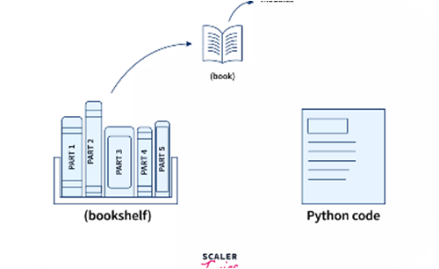
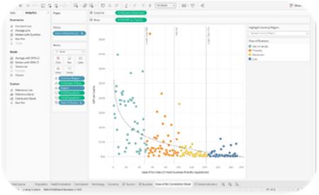



Tools used for this Project:
MS Excel
Python Libraries
Tableau
Pandas, NumPy, and Matplotlib are libraries used for data preprocessing and analysis. They provide more advanced functionality.
These spreadsheet tools are user-friendly and commonly used for basic data analysis and visualization tasks.
A visualization tool that simplifies complex data into interactive dashboards and visualizations.

Slide 5
The Importance of Weather Data Analysis
1
PREDICTIVE MODELING 🌡️
2
IMPROVED SAFETY
3
ECONOMIC IMPACT 💰
Climate models help predict future weather patterns, enabling us to make better decisions for agriculture, disaster management, and urban planning.
By understanding weather patterns, individuals and organizations can make informed decisions, minimizing the impact of severe weather conditions.
Weather events have a major impact on various industries, such as aviation, energy, and tourism. Analyzing weather data helps these industries predict and mitigate the economic impact.

Slide 6
Data Collection
Sources of Weather Data
Methods of Data Collection
Data Preprocessing
Weather data can be obtained from a variety of sources, such as national weather agencies, private companies, and citizen science initiatives
Data can be collected using weather stations, satellites, drones, or crowd-sourced data collection methods, such as personal weather stations and smartphone apps.
Before analysis, data must be cleaned, formatted, and prepared. This involves handling missing data, removing outliers, and normalizing data.

Slide 7

Data Preparation
Data Cleaning
Data Normalization
Raw data needs to be processed to remove or correct erroneous data that may affect analysis results, such as repeated or incomplete measures.
To minimize variation and make data easier to compare, normalization is used to adjust differences in scale, size, or other characteristics.

Slide 8
Exploratory data analysis
Data visualization tools, such as graphs and charts, allow users to easily understand trends and patterns in data and make predictions.
Visualization Techniques
Statistical Analysis
Predictive Modeling
Statistical methods enable us to identify patterns and trends in data, assess the accuracy of predictions, and make data-driven conclusions.
Machine learning algorithms and predictive models enable us to forecast future weather conditions and their impact.

Slide 9



VISUALIZATION

Slide 10
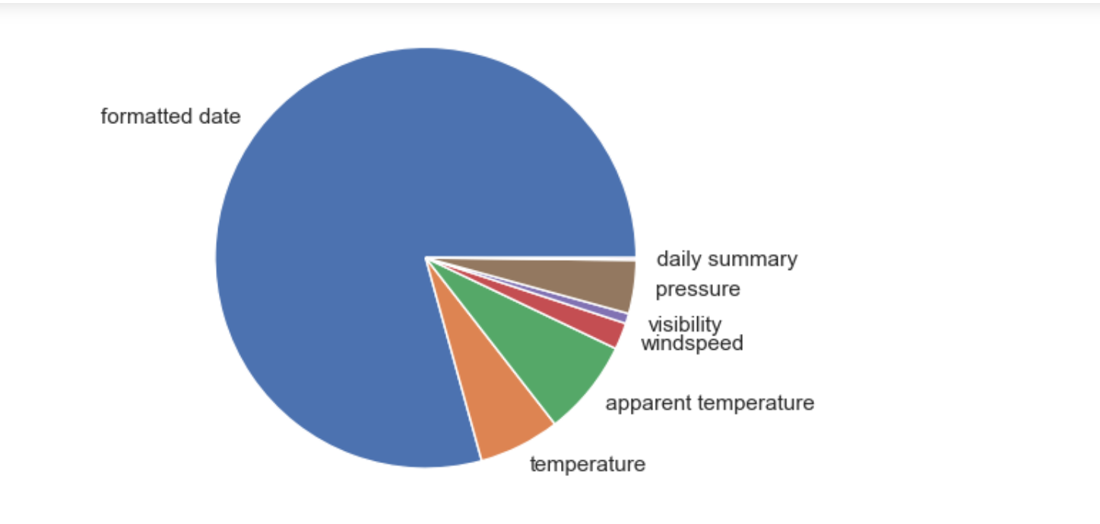
Pie﻿ Chart for Summary Count

Slide 11

Insights
The previous PIE CHART tells you about the summary of the given dataset. It provides you with the count for the given data . Here in this case, formatted data is more in number and the visibility count is the least.

Slide 12
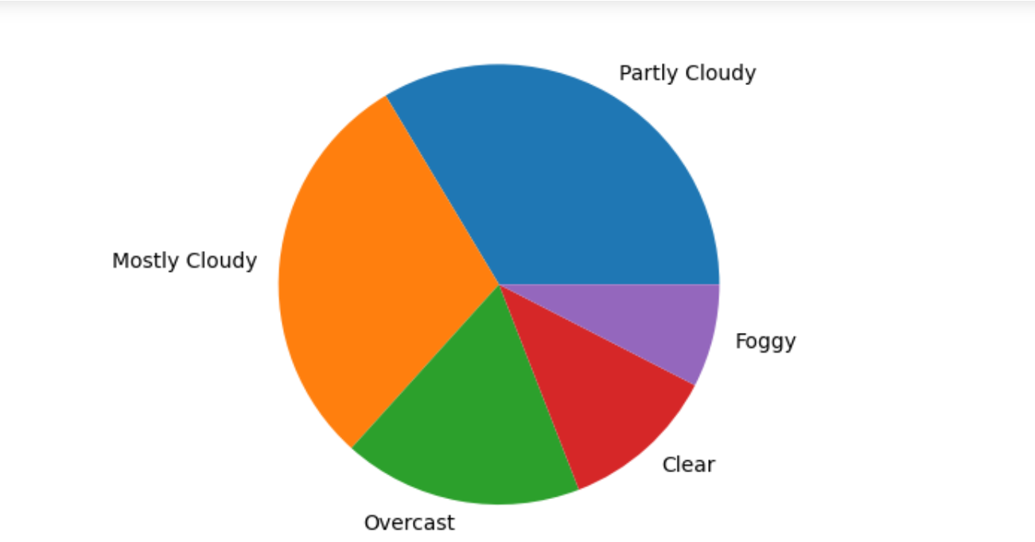
Representation of summary using pie chart

Slide 13
Insights
This PIE CHART shows you which weather condition occurred the most in the given dataset.

Slide 14
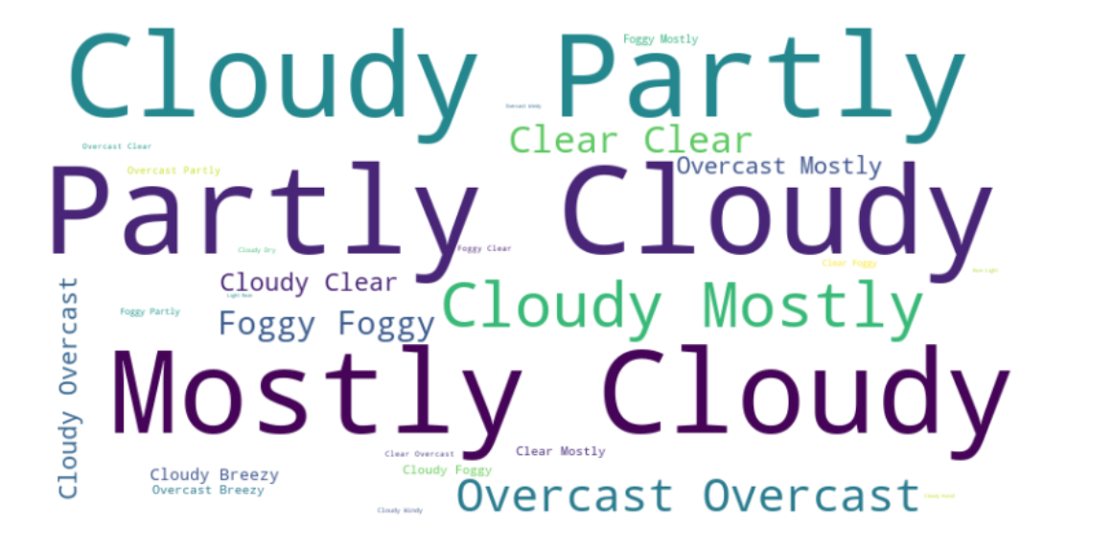
Word Cloud

Slide 15
Insights
The word cloud visually represents the frequency of Summary, with more frequently occurring Summary appearing larger in the cloud.

Slide 16
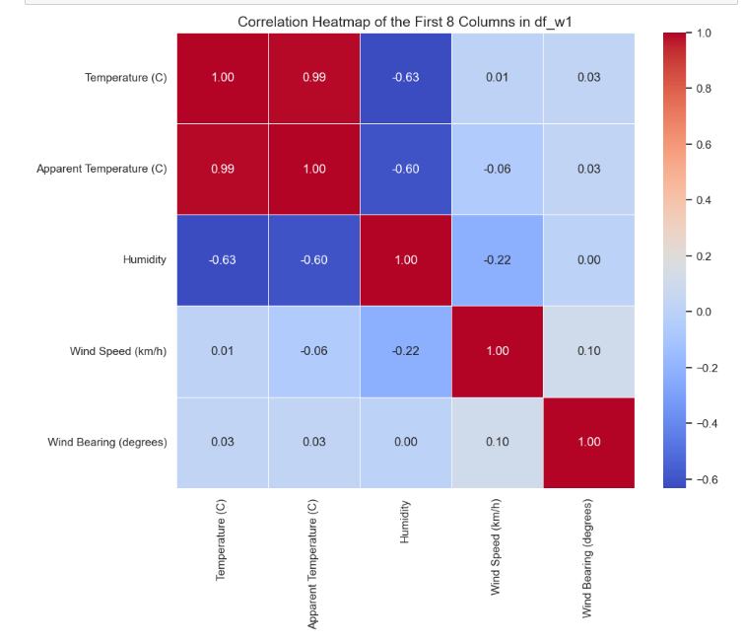
Heat Map
Representation of (Temp, Humidity, Visibility, Wind Speed, Apparent Temp)

Slide 17
Insights
The given HEATMAP explains you about the the correlation between the different parameters. As we can see here , the red color shows the maximum correlation between the parameters while the dark blue part shows the least correlation.

Slide 18
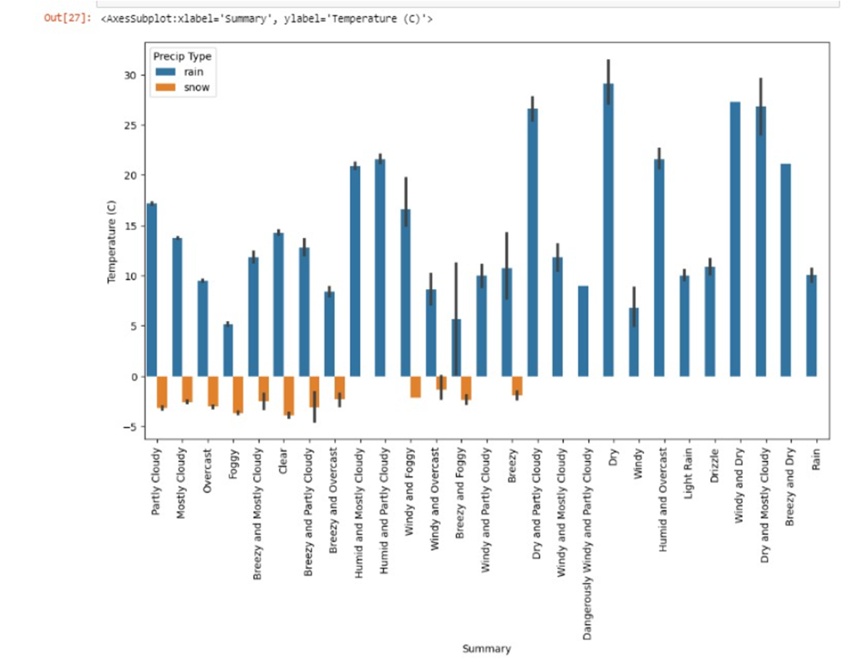
Bar Chart
Representation of Temp VS summary graph

Slide 19
Insights
The BAR CHART represents the relation between the summary and average temperature along with the precipitation type i.e. snow or rain.

Slide 20
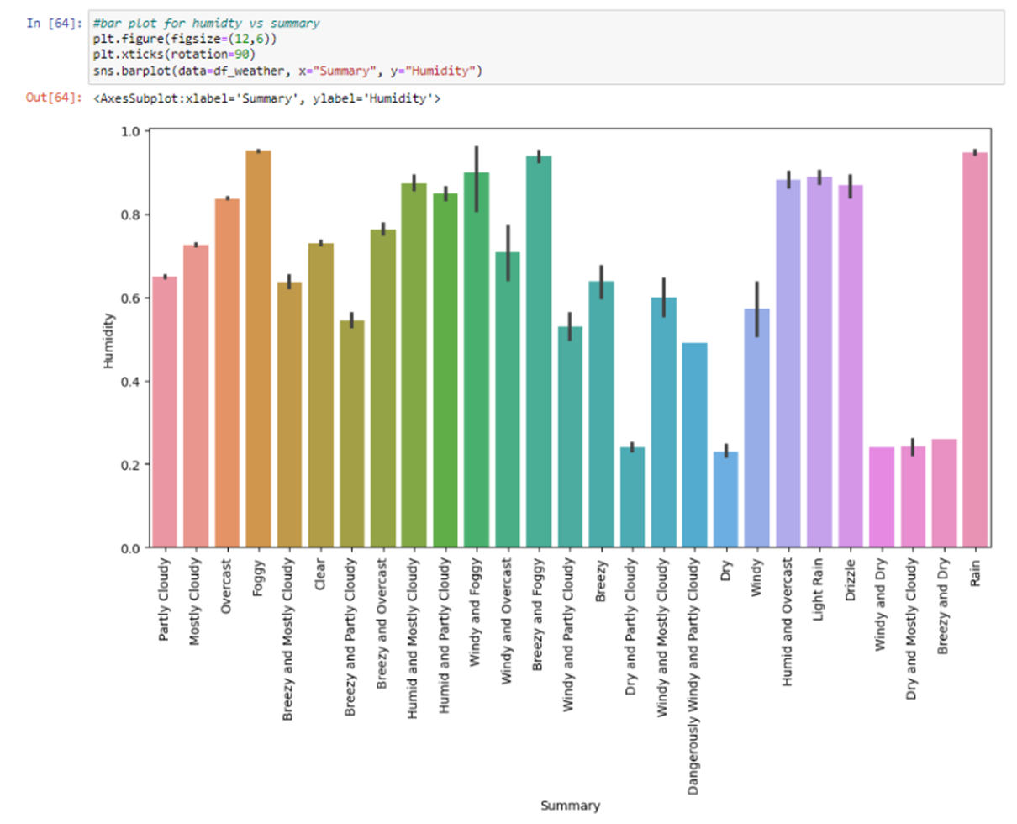
Representation of Humidity VS Summary using Bar plot

Slide 21
Insights
The visualization used here is the BAR PLOT which shows you how the weather condition is related to the humidity in the given data set. Here during RAIN, we observed the maximum humidity.

Slide 22
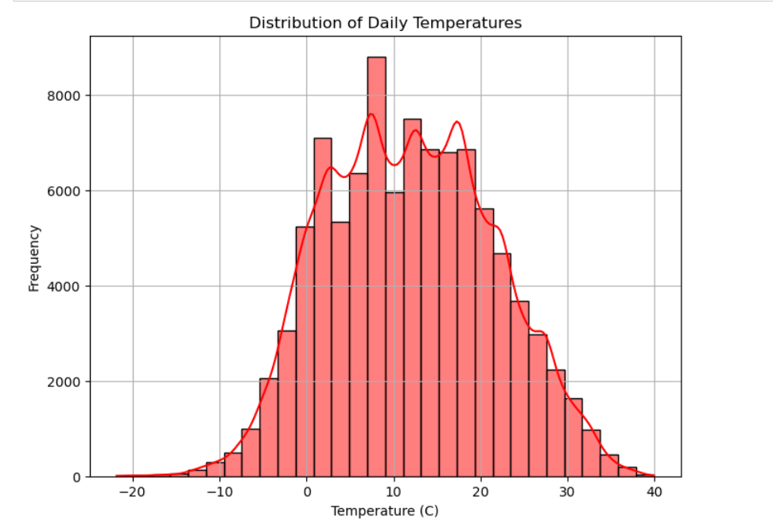
Histogram

Slide 23
Insights
The given visualization the distribution of daily temperatures using histograms or kernel density plots with the provided dataset.
Kernel density checks for the estimated probability density

Slide 24
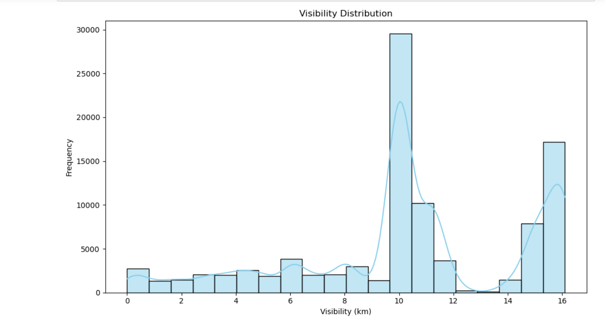
Histogram

Slide 25
Insights
Visibility is an essential weather parameter. Analyzing its distribution helps meteorologists understand typical visibility patterns, detect anomalies, and predict potential weather-related events. Here we are doing the same using HISTOGRAM.

Slide 26
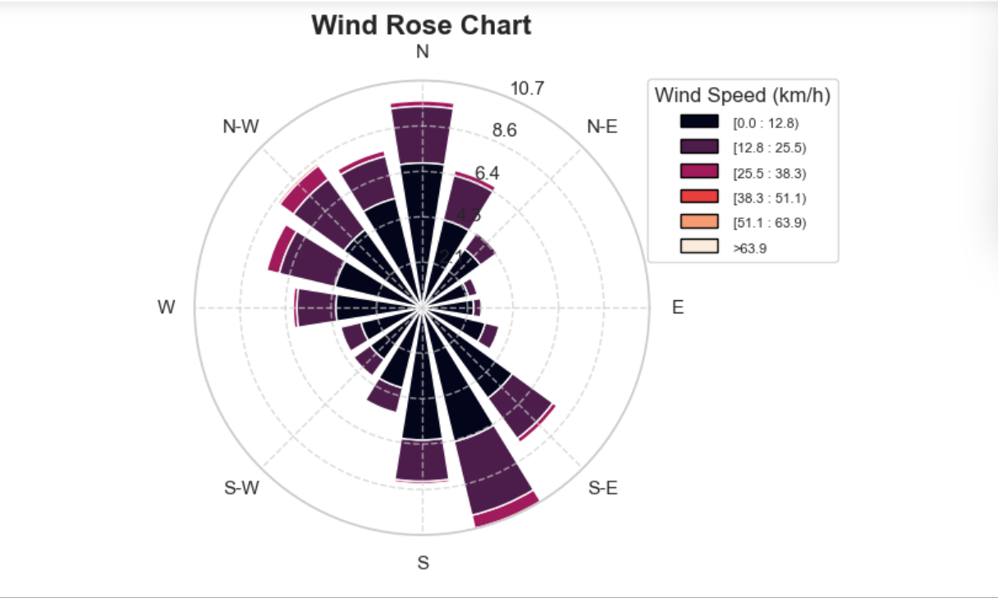
Wind Rose Chart

Slide 27
Insights
A wind rose depicts the distribution of wind direction and speed at a location over a period of time. The length of each bar represents the percent of time the wind blows from that direction. Each bar is subdivided with colors to show wind speed ranges associated with each direction.

Slide 28


TABLEAU

Slide 29
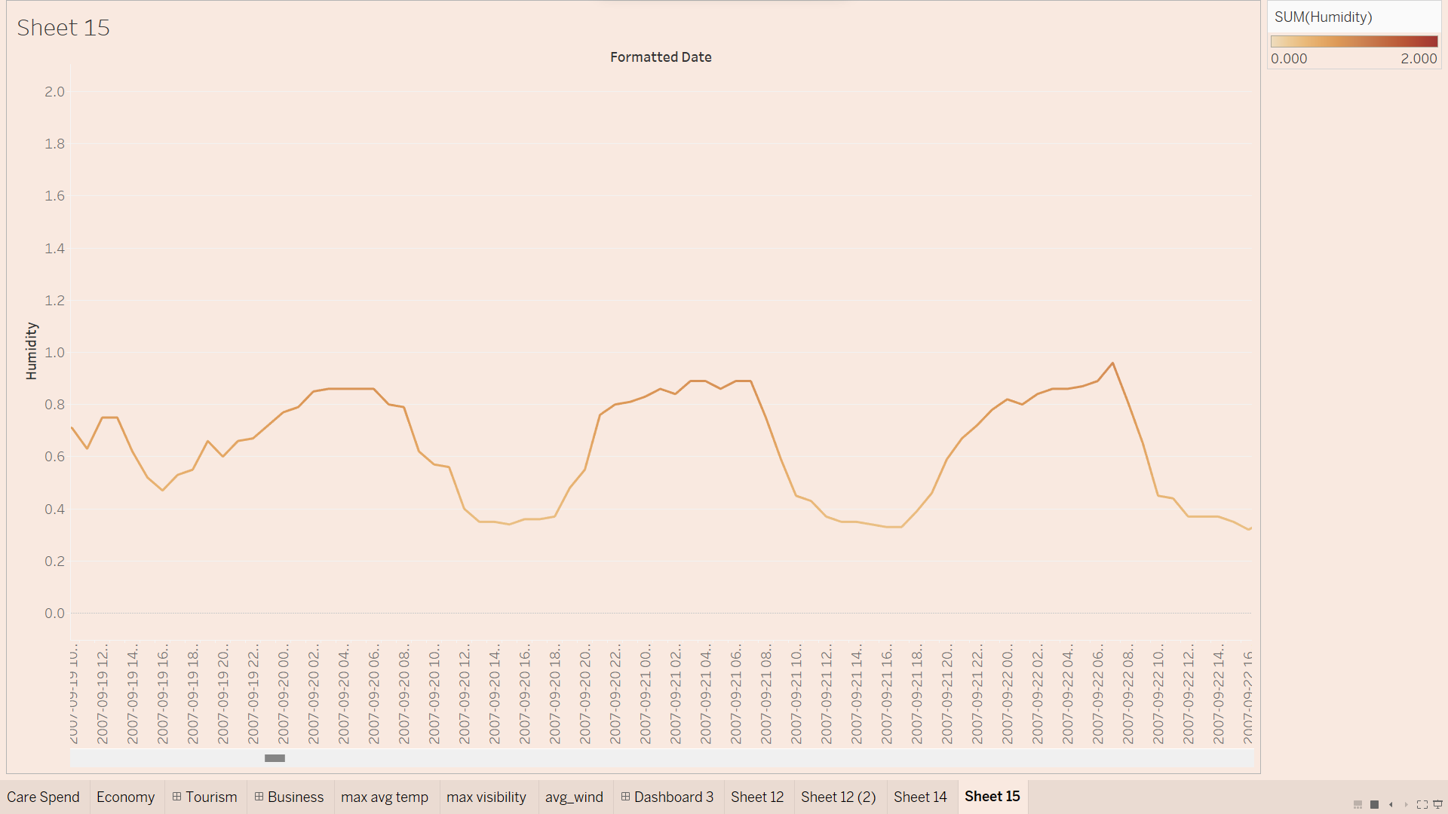

Slide 30
Insights
The LINE CHART here shows the variation in humidity over the formatted date. Here the data is taken for the year 2007 and the variation is showed for every hour.

Slide 31
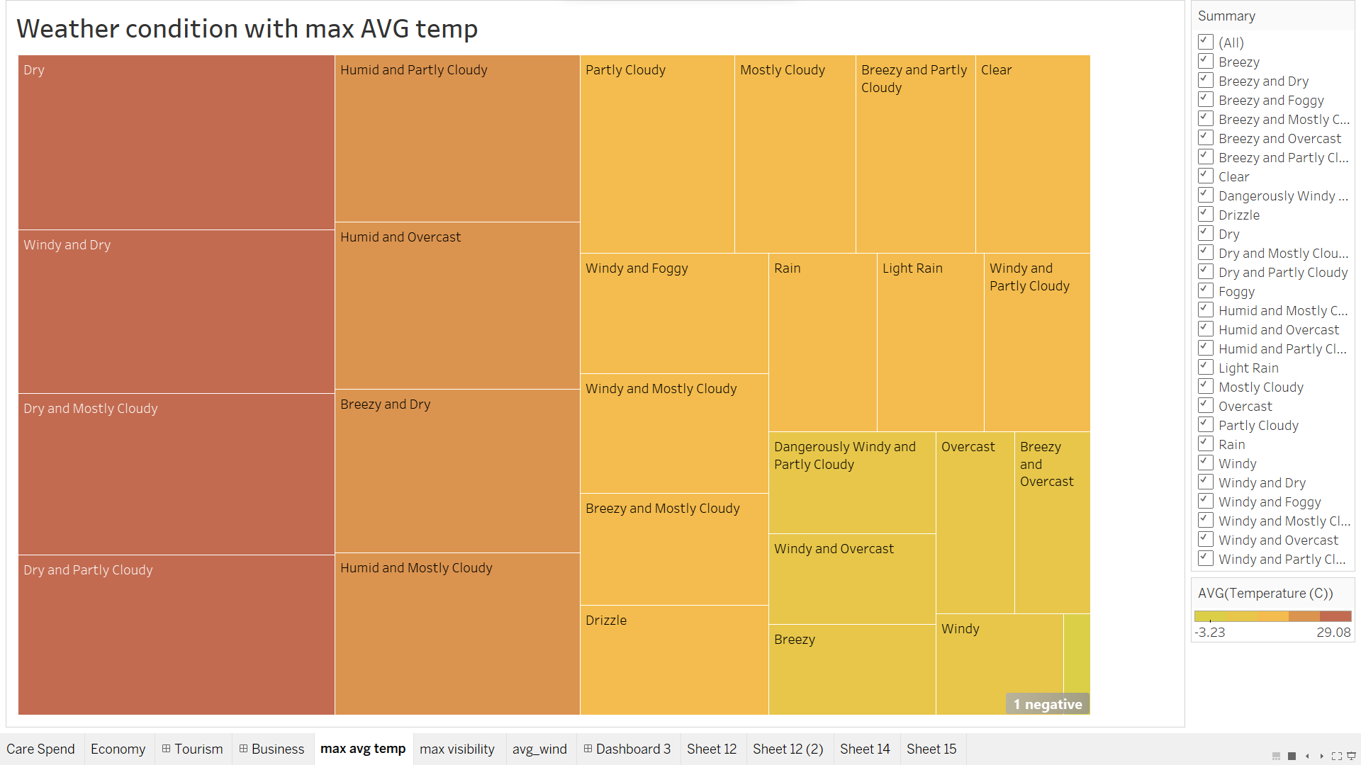

Slide 32
Insights
The visualization here used is TREEMAP which is used to display hierarchical (tree-structured) data.
Here in this case the DRY weather condition has the highest AVERAGE TEMPERATURE and is therefore placed in a bigger rectangle.

Slide 33
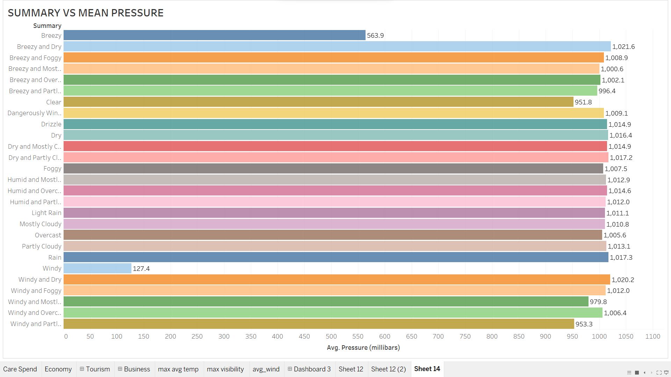

Slide 34
Insights
The chart compares the average atmospheric pressure for different weather summaries using a bar chart. This can reveal if certain weather conditions are associated with specific pressure patterns.

Slide 35
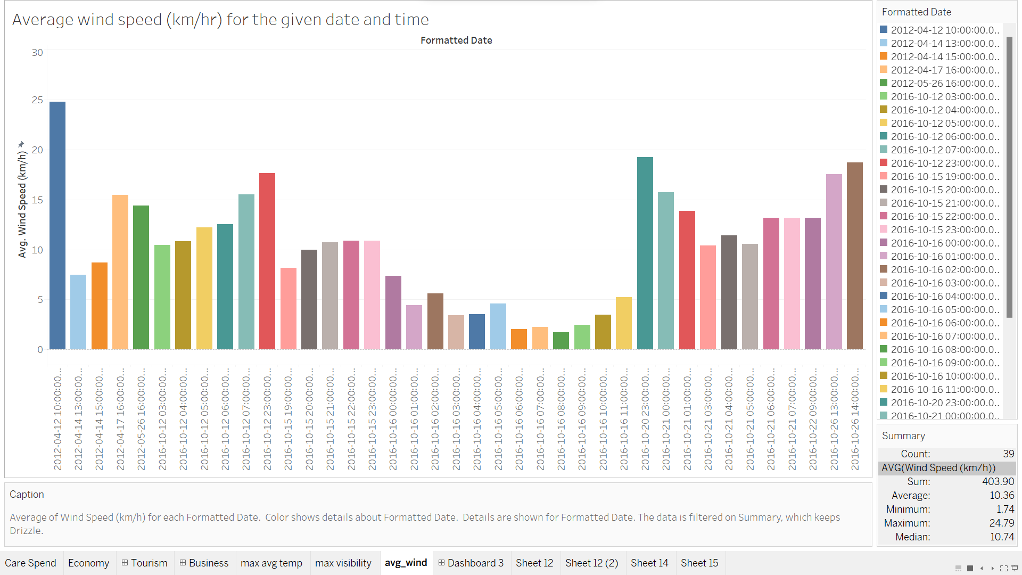

Slide 36
Insights
The bar plot here represents the AVERAGE of WIND SPEED (km/hr) for each FORMATTED DATE.
The colors show the details about the formatted date. The data is filtered on SUMMARY i.e. DRIZZLE.

Slide 37
Applications
Agriculture and Farming 🌾
Aviation
Disaster Response and Management
Weather data analysis can help farmers optimize crop yields, predict weather patterns, and minimize risks associated with crop failure.
Weather plays a critical role in aviation safety, and weather data analysis helps pilots and air traffic control teams make informed decisions to ensure safe and efficient travel.
Weather data analysis helps emergency responders prepare for and mitigate the impact of natural disasters, such as hurricanes, floods, and forest fires.

Slide 38

Conclusion
Global warming is increasing the frequency and intensity of some types of extreme weather.
From the analysis, we have gathered useful insights over the past 10 years.
For example, warming is causing more rain to fall in heavy downpours.
There are also longer dry periods between rainfalls. This, coupled with more evaporation due to higher temperatures.
Wet places have generally become wetter, while dry places have become drier.

Slide 39


THANK
YOU!

